Slide 1
Pivot Table

Slide 2
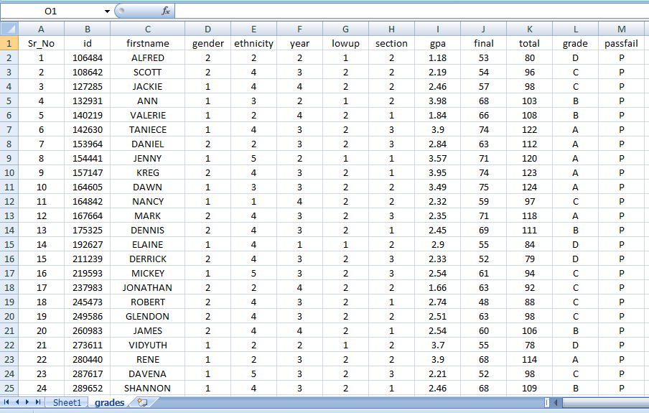
Your Data File grades

Slide 3
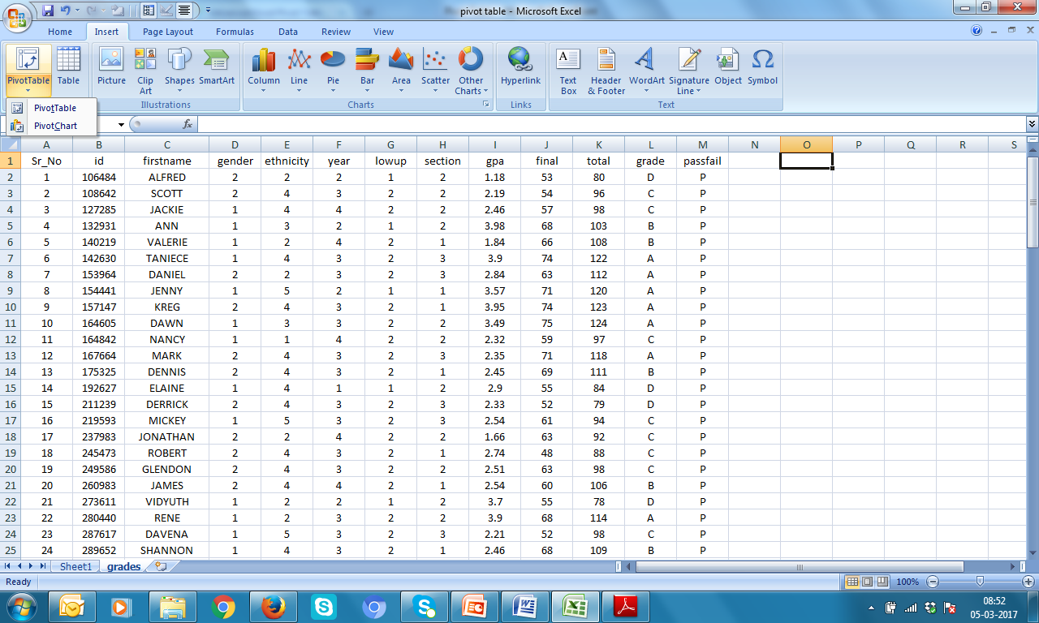
Insert → PivotTable →PivotTable

Slide 4
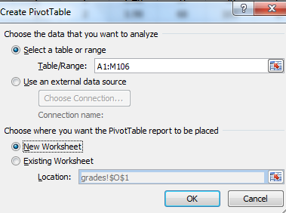
Feed Table/Range as A1:M106 New Worksheet → OK

Slide 5
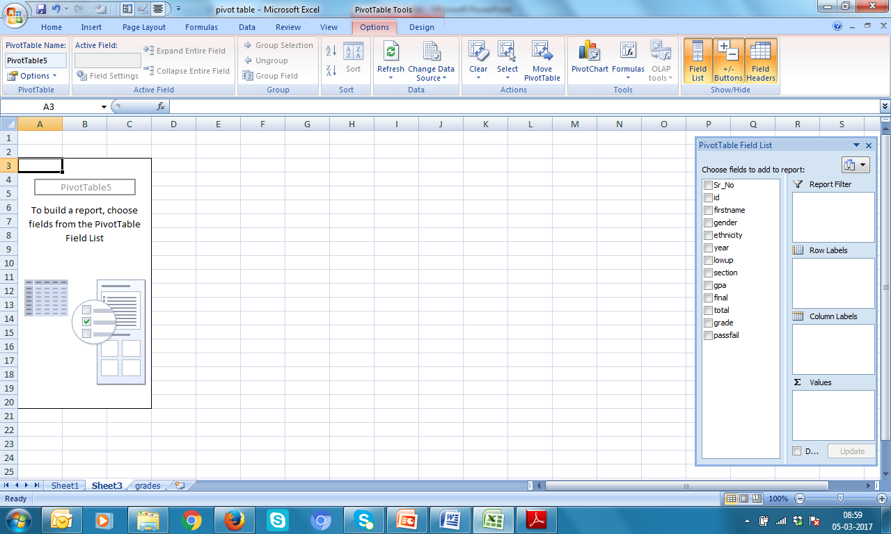
Table will appear here
All variables
Lets drag ethnicity in Row Labels & section in Column Labels & final in values

Slide 6
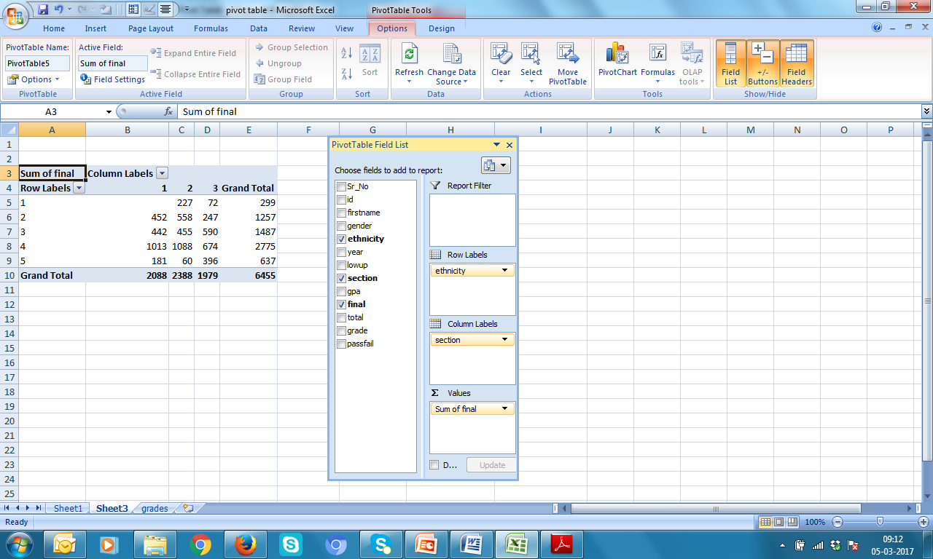
Score of final across ethnicity and sections
Sum of final category wise is not
Making any sense! Lets find average

Slide 7
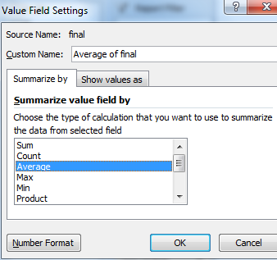
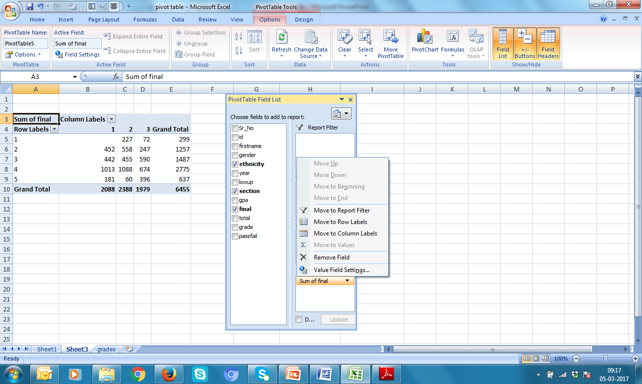
[3] select Average → OK
[2] Click Value Field Settings…
[1] Click here. A dialogue box will pop up

Slide 8
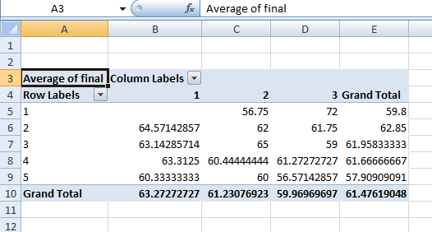
Now this makes sense! Can you keep decimals up to 2 points?

Slide 9
Now looks fine
Average of final | Column Labels
Row Labels | 1 | 2 | 3 | Grand Total
1 |  | 56.75 | 72.00 | 59.80
2 | 64.57 | 62.00 | 61.75 | 62.85
3 | 63.14 | 65.00 | 59.00 | 61.96
4 | 63.31 | 60.44 | 61.27 | 61.67
5 | 60.33 | 60.00 | 56.57 | 57.91
Grand Total | 63.27 | 61.23 | 59.97 | 61.48

Slide 10
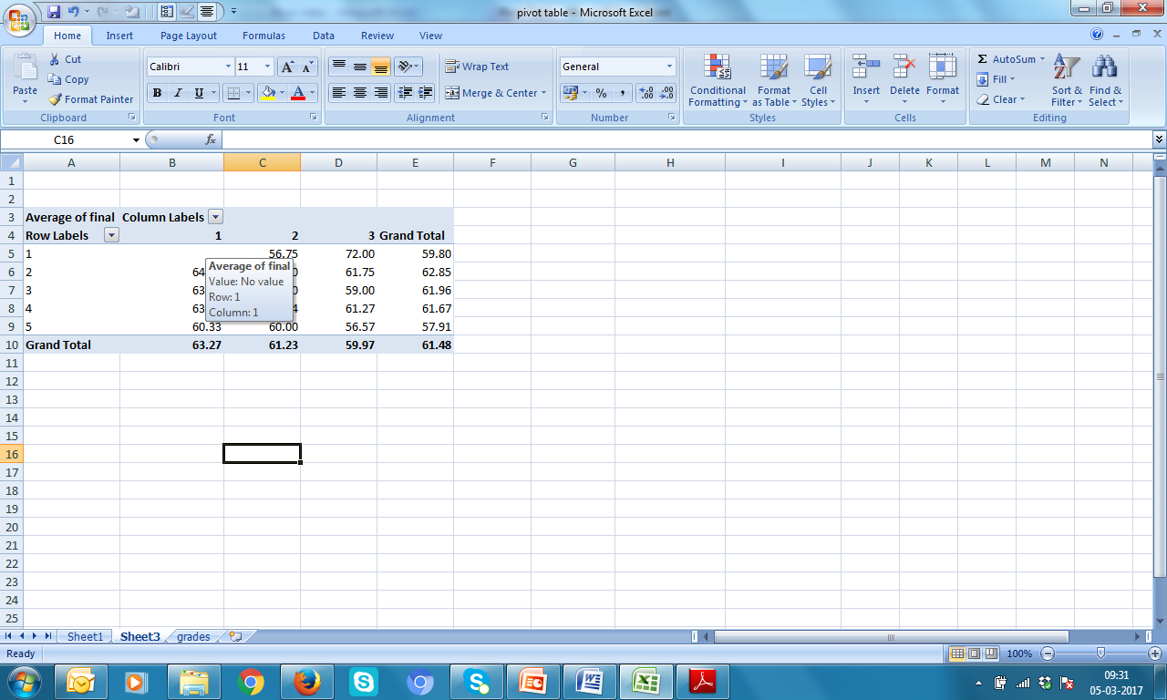
Probing each cell

Slide 11
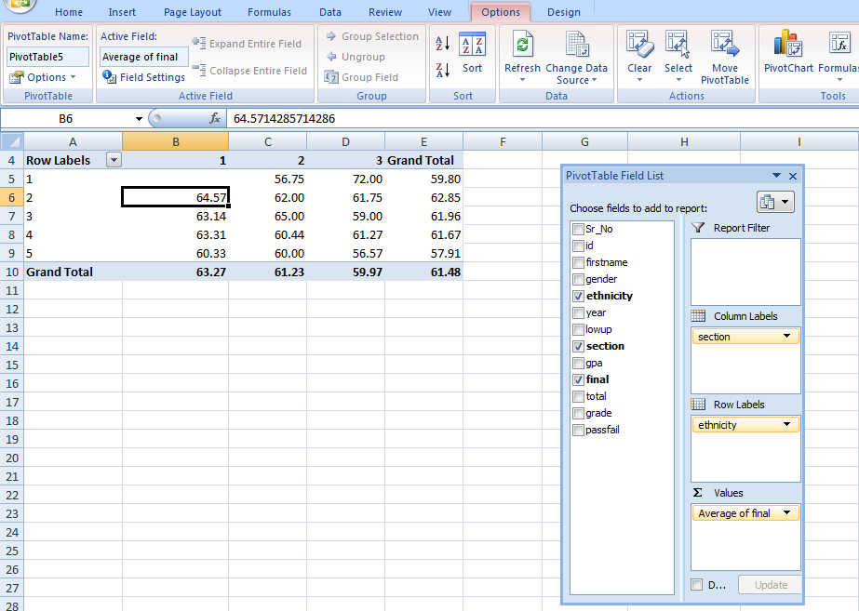
Click at any cell of pivot table
Click Options
Click Pivot chart

Slide 12
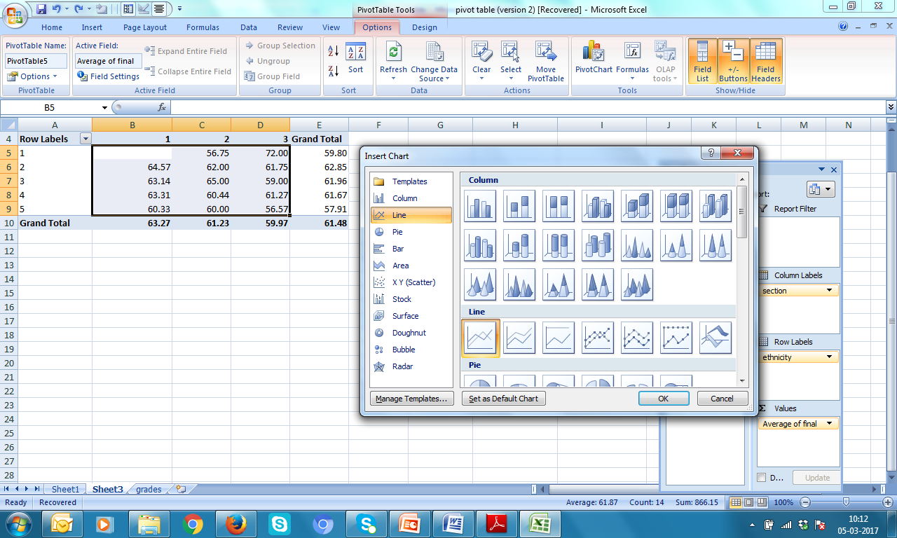
Select range
Select Line diagram
OK

Slide 13


Need to make it presentable!

Slide 14
Line Graph of Averages of final

Slide 16
Counts
Count of final | Column Labels
Row Labels | 1 | 2 | 3 | Grand Total
1 |  | 4 | 1 | 5
2 | 7 | 9 | 4 | 20
3 | 7 | 7 | 10 | 24
4 | 16 | 18 | 11 | 45
5 | 3 | 1 | 7 | 11
Grand Total | 33 | 39 | 33 | 105

Slide 17
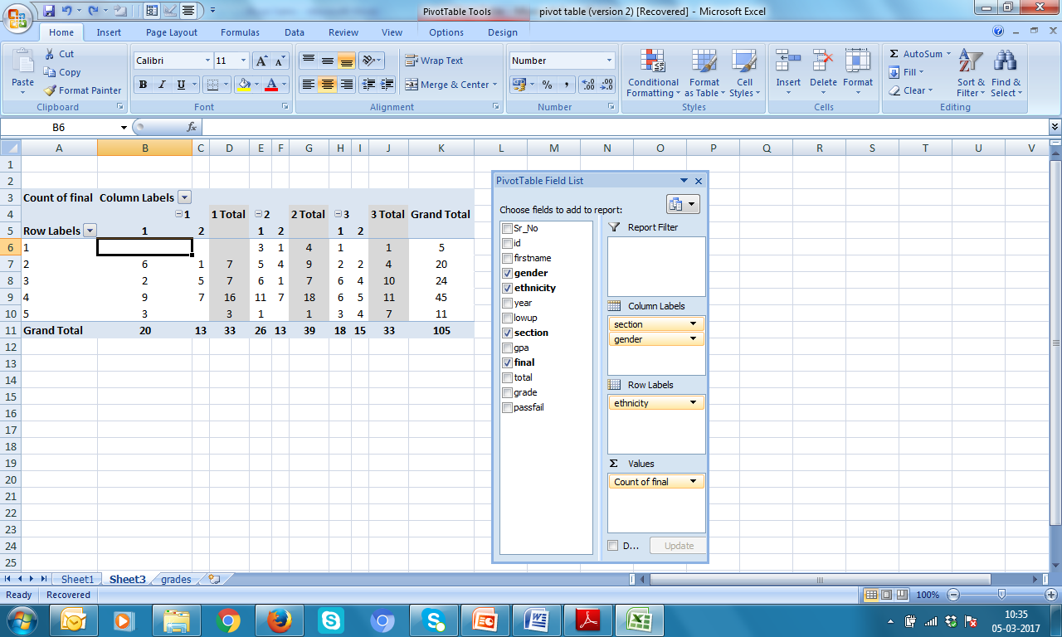
Add gender in the Column Labels
Count of final | Column Labels
 | 1 |  | 1 Total | 2 |  | 2 Total | 3 |  | 3 Total | Grand Total
Row Labels | 1 | 2 |  | 1 | 2 |  | 1 | 2
1 |  |  |  | 3 | 1 | 4 | 1 |  | 1 | 5
2 | 6 | 1 | 7 | 5 | 4 | 9 | 2 | 2 | 4 | 20
3 | 2 | 5 | 7 | 6 | 1 | 7 | 6 | 4 | 10 | 24
4 | 9 | 7 | 16 | 11 | 7 | 18 | 6 | 5 | 11 | 45
5 | 3 |  | 3 | 1 |  | 1 | 3 | 4 | 7 | 11
Grand Total | 20 | 13 | 33 | 26 | 13 | 39 | 18 | 15 | 33 | 105

Slide 18

Exercise
Consider same data file pivotE.xlsx and
(i) create pivot tables and plot line diagrams for gpa (average, maximum, minimum, standard deviation) across lowup and section.
(ii) Find counts in each category
(iii) Add year also in analysis and find counts

